Slide 1

Research on Remote Sensing Applications in Malta
Massimo Darmanin & Frankie Inguanez
Institute of Information & Communication Technology
MCAST, Paola, Malta

Slide 2
Problem Definition
Since the 1980’s, satellite technology has advanced to support an ever more accurate sensory reading and data collected.
Prior to the recent economic boom Malta has experienced, its governing people never found the need to seek the potential uses of remote sensing.
However with the recent shift in the economy and a diversification of influence from foreign investments, a new and better way of Monitoring and Surveying our country is needed.

Slide 3
Aim and Hypothesis
Prove viability of remote sensing by making use of the spectral range the Sentinel-2 missions has to offer.
Choosing three different scenarios relevant to the Maltese country and replicating similar scenarios from around the world.
Although remote sensing has drastically improved, here are still some major limitations when monitoring a small island compared to other countries.
However, certain techniques and features can still be useful for Malta’s needs.

Slide 4
Research Questions
Is remote sensing a viable option for Malta?
What are the applications of remote sensing best suited for Malta?
Are these options reliable?

Slide 5
Literature
Sentinel-2 imagery for mapping and monitoring imperviousness in urban areas. (Kuc and J. Chorma ́nski, 2019)
In this article, Kuc and J. Chorma ́nski gathered relevant data gathered from Sentinel-2 and combined the Google Earth HR imagery and Open Street Map to present a high-resolution image of a built up area in a part of the city of Warsaw.
They noted that NDVI (Normalized Difference Vegetation Index) could be used to map built-up areas.
NDVI was improved into NDBI (Normalized Difference Build-up) which they showed was better suited to differentiate buildings from the landscape.

Slide 6
Literature
Mapping of forest fire burned severity using the sentinel datasets (KV, Suresh Babu and Roy, Arijit and Aggarwal, Ridhika, 2018)
In this article, used variants of NDVI to to map the severity of the burned area over Uttarakhand districts.
These variants were the Differenced Normalized Burn Ratio (dNBR) and Relativized Burn Ratio (RBR).
Since Sentinel-2’s band3 and band8 have a spatial resolution of 10m while band 12 has a spatial resolution of 20m, the data had to be resampled to 20m, hence losing the quality.
It was also noted that water bodies will show up as false-positive since it is picked up in a similar spectral reflectance as burnt areas

Slide 7
Literature
Specific features of NDVI, NDWI and MNDWI as reflected in land cover categories (Szabo, Szilard and G‘acsi, Zolt‘an and Balazs, Boglarka, 2016)
This study determined that NDVI could also be used to map water bodies efficiently.
The index was then split into two sub indices, NDWI (Normalized Difference Water Index) and MNDWI (Modification of Normalized Difference Water Index).
It was noted that all three indices more or less behaved similarly, however MNDWI enhanced water features such as ponds and rivers better than the rest.

Slide 8
Methodology
This research shall explore three different scenarios, by using the data gathered from Sentinel-2 MSI, available from the publicly available Copernicus database.
Each individual scenario chosen, will have each a different time frame and study area related to some event or use case in Malta.
Data was gathered from the Copernicus database by using the freely available SentinelApi.
Each study area was mapped using QGIS, an open-source geographic information application.

Slide 9
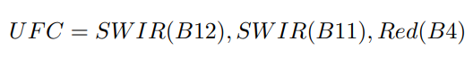
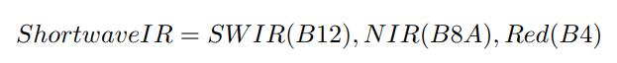
Methodology
The first scenario involves the monitoring of urban sprawling in Hal Far through a span of 6 years.
Data was gathered annually between July and August.
Data gathered was computed into RGB, Urban False Colour (UFC) and SWIR (Short Wave Infra-Red)

Slide 10
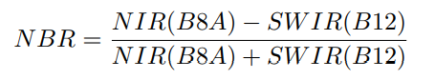
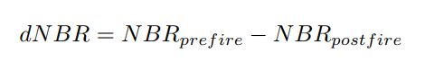
Methodology
The second scenario will focus on the Mizieb fire which happened in the Summer of 2019.
Two data sets were gathered, one on the 23rd of May 2019 (pre-fire) and the other on the 27th of June 2019 (post-fire).
Due to short luck and the way the orbital window works, closest date without cloud coverage prior the fire was almost a month old.
Data gathered was computed into RGB and NBR.
dNBR (Differenced Normalized Burn Ratio) was calculated by using data gathered from pre-fire minus data gathered from post-fire.

Slide 11
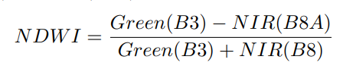
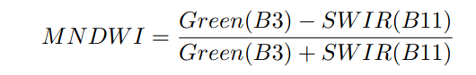
Methodology
The third scenario will monitor the water flowing through the valley of Chadwick Lakes through a span of one year, with data gathered once a month.
NDWI (Normalized Difference Water Index) and MNDWI (Modification of Normalized Difference Water Index) were used to compute the data while RGB was used as a reference.

Slide 12
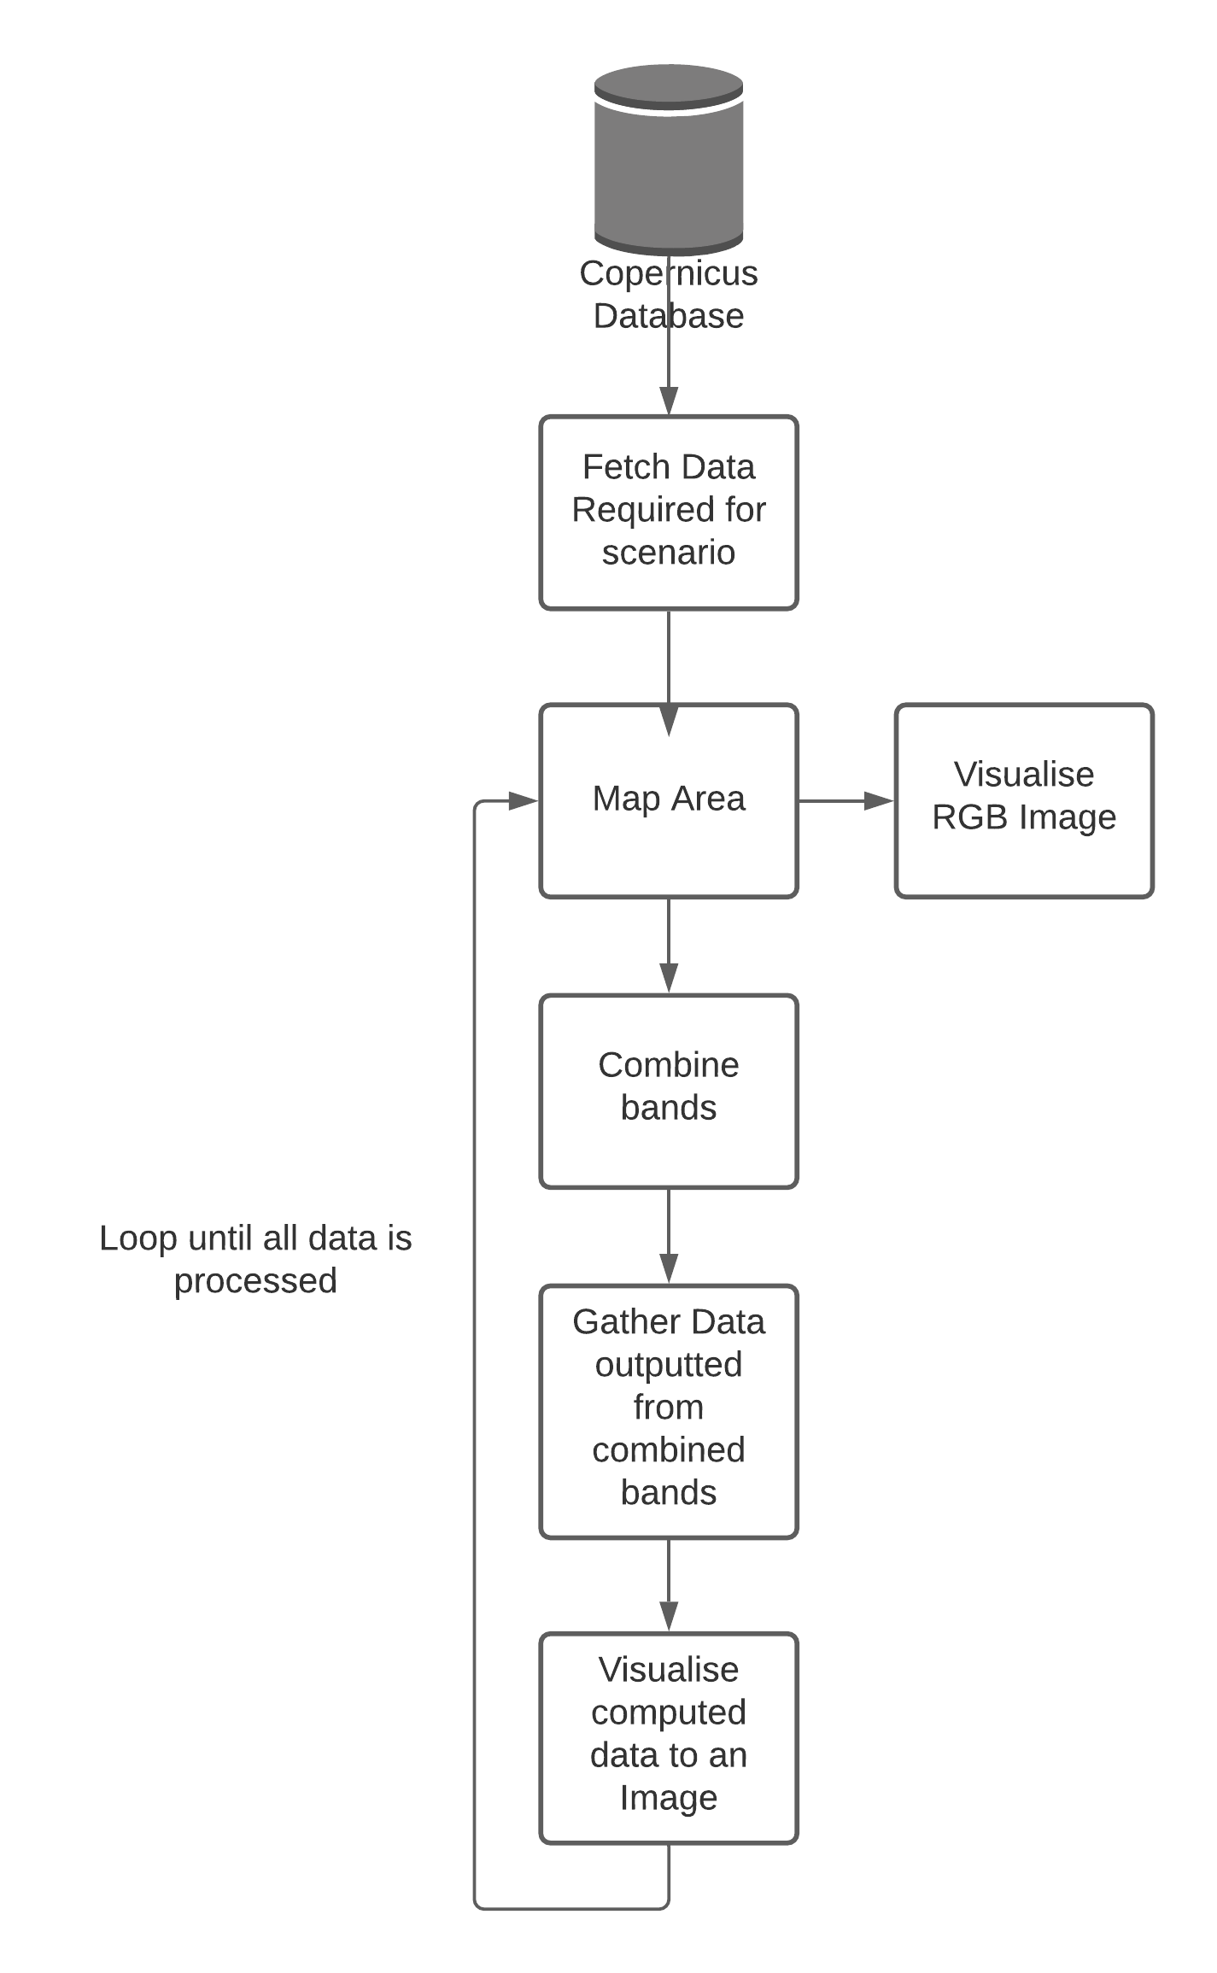
Methodology

Slide 13
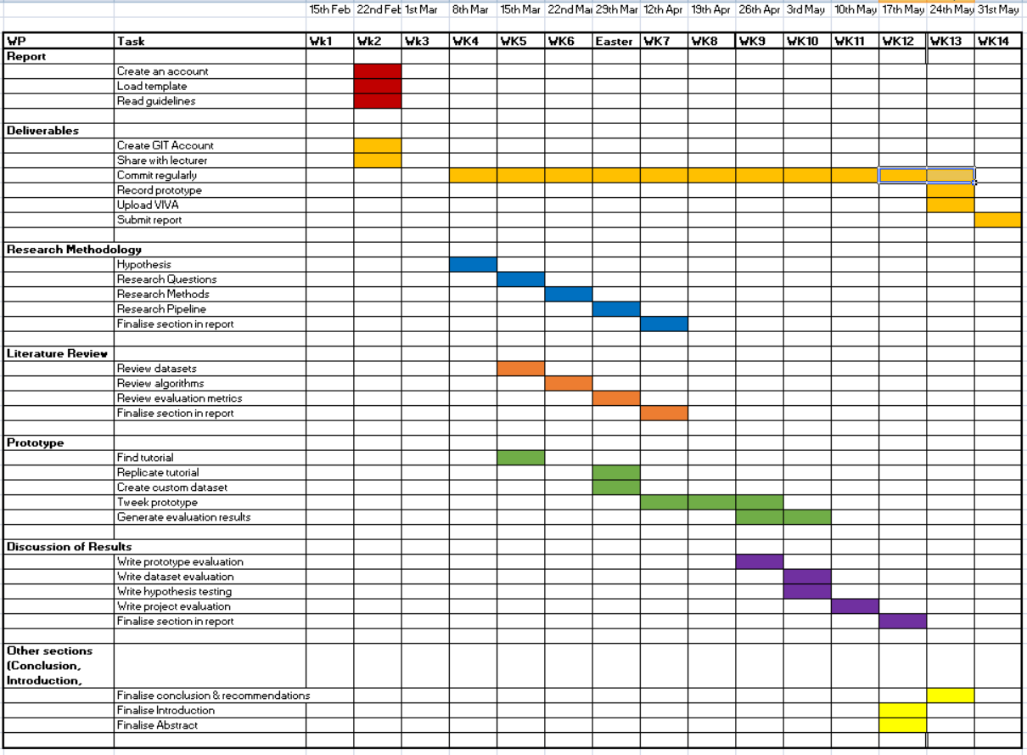
Methodology – Proposed Project Plan

Slide 14
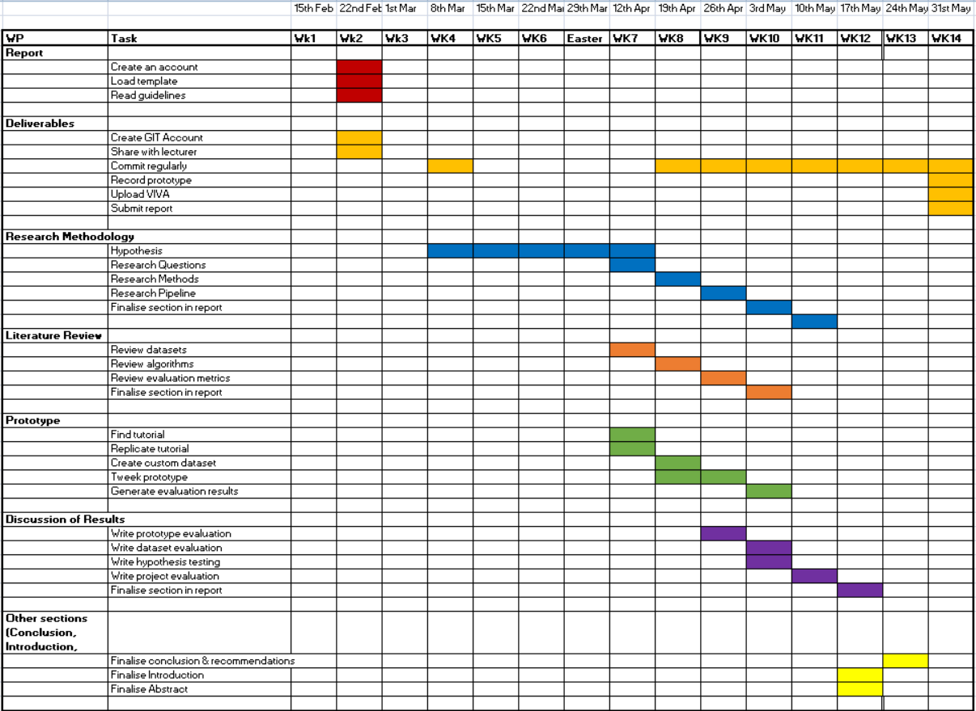
Methodology – Actual Project Plan

Slide 15
Methodology – Actual Project Plan
Hypothesis idea took way longer than expected due to the fact that I had to tone down my idea several times until it became viable for this project
Couldn't commit as planned due to not having an idea as planned.
Realistically expected to finish earlier but due to taking too long to find a viable idea I had no choice but scram till the last week

Slide 16
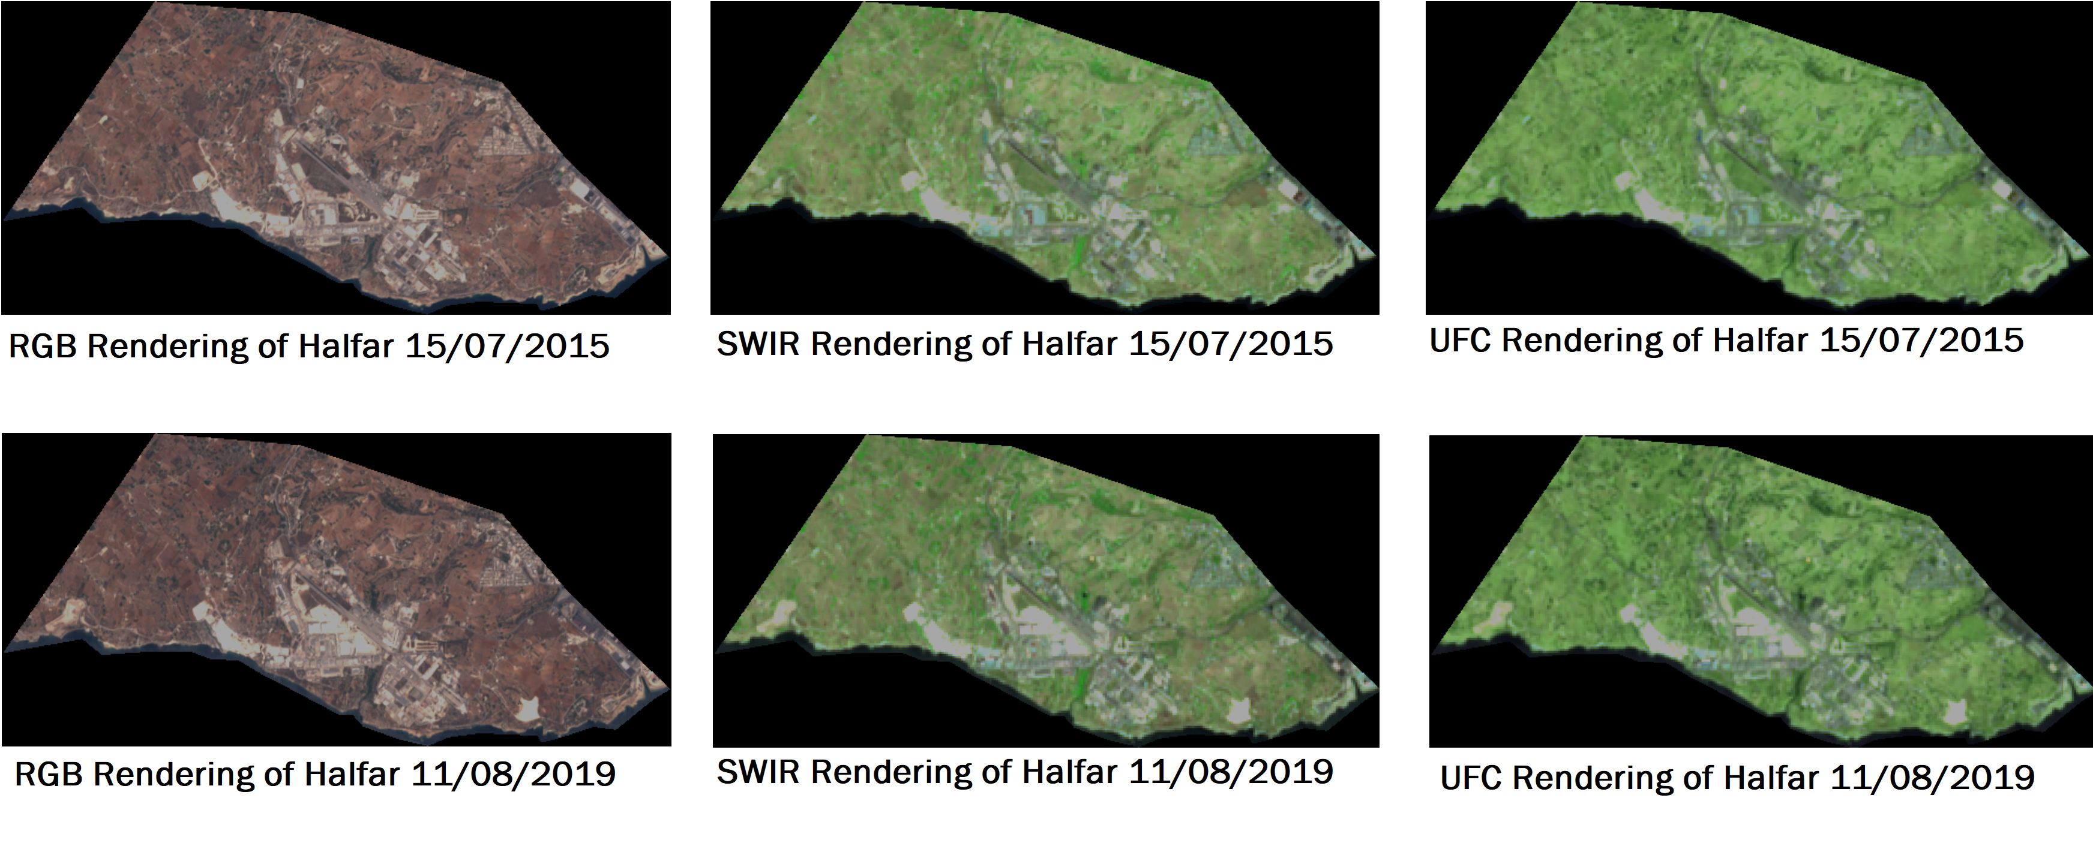
Data Computed
Showing earliest data collected vs oldest data collected.

Slide 17
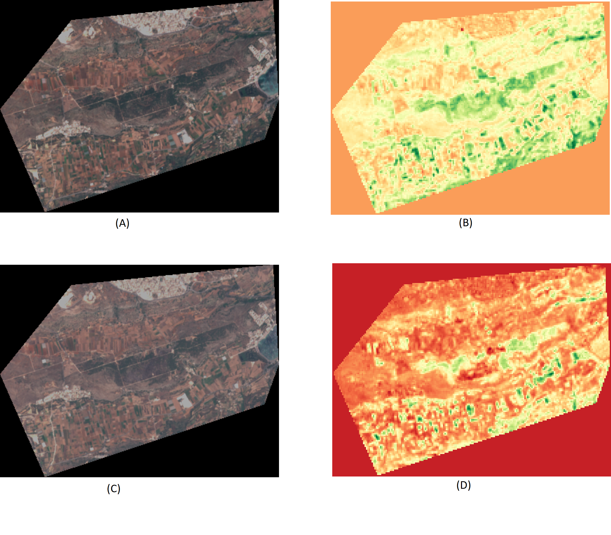
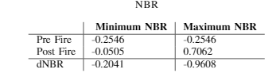
Data Computed
Showing data from May 23rd and June 27th 2019.
A) RGB render (pre-fire)
B) NBR render (pre-fire)
C) RGB render (post-fire)
D) NBR render (post-fire)

Slide 18
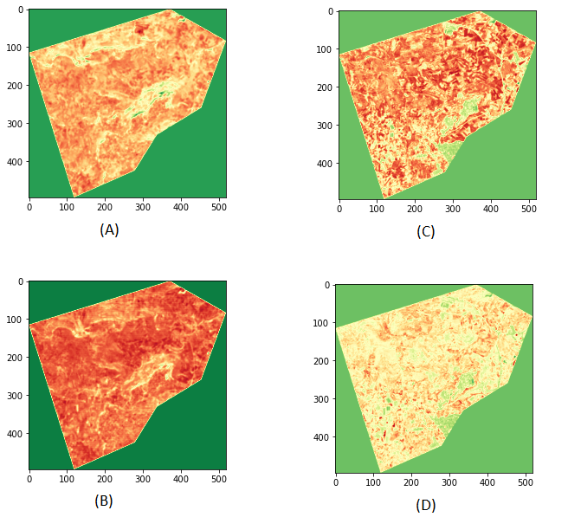
Data Computed
Showing only data from February 2020 and August 2020.
A) MNDWI rain-season (February)
B) MNDWI dry-season (August)
C) NDWI rain-season (February)
D) NDWI dry-season (August)

Slide 19
Data Evaluation
From the first scenario it was deducted that UFC (Urban False Colour) was the most suitable for monitoring urban sprawling as it rendered buildings more vividly than NDBI.
From the second scenario NBR was used successfully to compute and monitor an area affected by fire. dNBR (Differenced Normalized Burn Ratio) was calculated using pre-fire and post fire data.
From the third scenario both indexes gave out different results, outlining different characteristics of the area, such as vegetation and soil conditions. However from the results shown, it is clear that with Sentinel-2 instruments, it is still not fit for purpose for monitoring water objects in Malta.

Slide 20
Prototype
https://youtu.be/rA5pVjAzXAU

Slide 21
Conclusions
Two out three scenarios proved to have greater potential and could even be further improved to adhere to Malta’s needs.
Urban monitoring as it is could be automated and instructed to map and monitor urban sprawling around the country periodically
Assessing fire damages proved to be promising, even though there are very limited forested areas on the island

Slide 22
Conclusions - Limitations
The scenarios chosen had to be limited to the data available from 2015 with an interval of an approximated 5 day interval.
Remote Sensing is rendered useless on cloudy days.
Remote sensing lagged behind when it came to mapping water bodies. This could be due to a number of factors, such as an ever decrease in rainfall on the island, making it harder to detect.
Due to time limitation, not much effort went into allocating the processing of data to the GPU and instead relied on the processing power of the CPU.

Slide 23
Future Recommendations
Integrate more satellites to the research.
Explore more scenarios Malta has to benefit from Remote Sensing.
Use HSV efficiently to extract further data from computed images.

Slide 24
References
G. Kuc and J. Chorma ́nski, “Sentinel-2 imagery for mapping andmonitoring imperviousness in urban areas,”International Archives ofthe Photogrammetry, Remote Sensing and Spatial Information Sciences,vol. 42, no. 1/W2, 2019.
S. B. KV, A. Roy, and R. Aggarwal, “Mapping of forest fire burnedseverity using the sentinel datasets,”International Archives of the Pho-togrammetry, Remote Sensing and Spatial Information Sciences, vol. 42,p. 5, 2018.
S. Szabo, Z. G ́acsi, and B. Balazs, “Specific features of ndvi, ndwi andmndwi as reflected in land cover categories,”Landscape & Environment,vol. 10, no. 3-4, pp. 194–202, 2016.

Slide 25
Thank you Name Surname, Frankie Inguanez

